Slide 1
Dear Students , the Digital Future of India – the next Superpower
We are running a Digital payment System Awareness campaign to help people live happy without cash and carry out safe transactions. Your co operations is very important here because you are the real future of India
Kindly go through the ppt and try to make yourself, your family, friends , neighbors and relatives aware and educate about Digital payment System
This will help people in the post demonetized India to live cashless without the worry of actual cash.
Kindly educate at least 10 people and note there names, I am sure; You being responsible, can educate more people
If you can take their photos (selfi, group photo, individual ) will be much appreciated . Kindly submit the name list or photos after you come back from vacation. it will help our RGUKT campaign
Happy Vacations

Slide 2
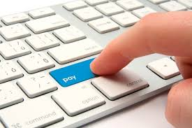
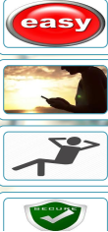
Vittiya Saksharata Abhiyaan
(VISAKA)
Campaign by Higher educational institutions for digital economy
It is easy to use
Anytime ,anywhere, anyone
Convenient
Secure

Slide 3
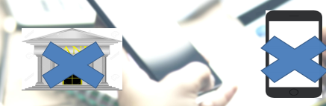
No bank account, no mobile?
You can still go digital
Open a Jandhan account in the nearest Bank – get RuPay card or
Take a prepaid card from employer and PIN

Slide 4
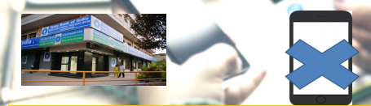
Have a bank account, no mobile
You can still go digital
Ask Bank to issue RuPay card
Swipe your card for all purchases

Slide 5
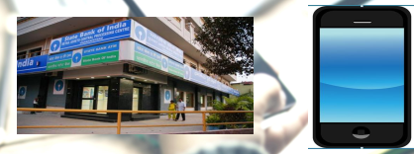
Have a bank account & a smart phone?
You can go digital
Use RuPay / Debit card – PoS
Use Mobile wallets

Slide 6
Students
Understand /adopt all the cashless modes of payments
Train own family in using cashless modes
Adopt 10 households and teach them digital payments
Register as Volunteer on http:mhrd.gov.in/vabhiyaan/

Slide 7
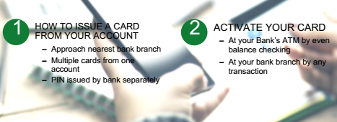
Getting a Bank Card

Slide 8
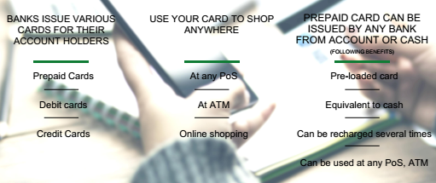
Points of Sale (PoS) & Cards steps

Slide 9
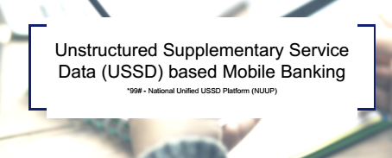
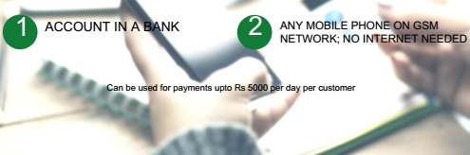
Required for Activation

Slide 10
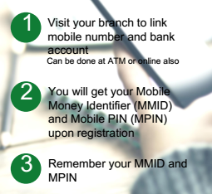
Registration
Now changes being brought to simplify user experience: no need for separate MMID

Slide 11
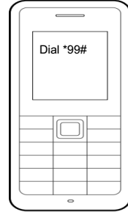
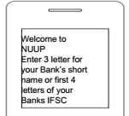


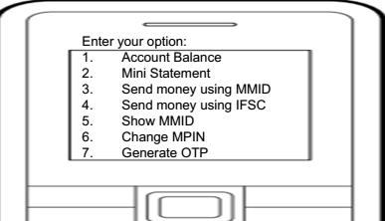


Slide 12

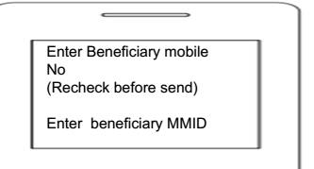
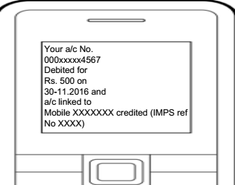

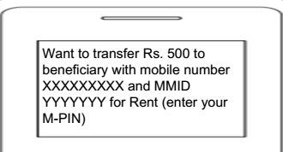


Slide 13
What are e-wallets?
Electronic pre-paid payment system, mobile – first
Used in purchasing items on –line with a computer or a Smartphone at a store.
An invidual’s account is required to be linked to the digital wallet to load money in it.
Most bank have their a wallets and some private companies

Slide 14
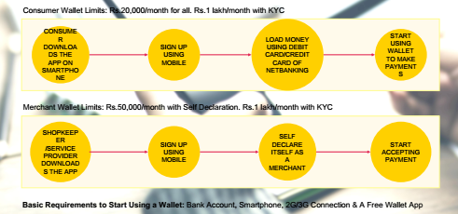
Using Wallets

Slide 15
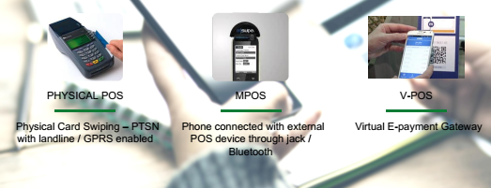
Types of PoS

Slide 16
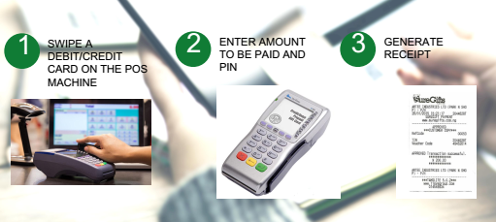
Physical PoS

Slide 17
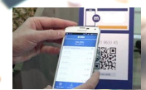
V- PoS
No PoS machine required
QR code used for payment to bank account of merchant
Complete privacy of merchant bank account

Slide 18
Must Do Practices
Register your mobile number at bank for regular information by SMS for every transaction
Never share your PIN to anyone
Transaction at only trusted merchants
While at ATM, ensure no one is looking over your shoulders

Slide 19
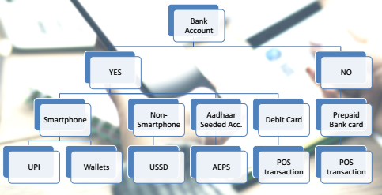
Summary

